Slide 1

Mock Presentation Part 1
Moris

Slide 2
Intro
Skit - we pretend that we all have a different idea and presentation and not teamwork and we not to be called the dream team. We are the nightmare team.
What is github
Largest and most widely adapted Version Control repository management platform
Why github? – We will show you!
Notes:
We are gonna use the time before the 8 mins to start it
So we have 9 mins total

Slide 3
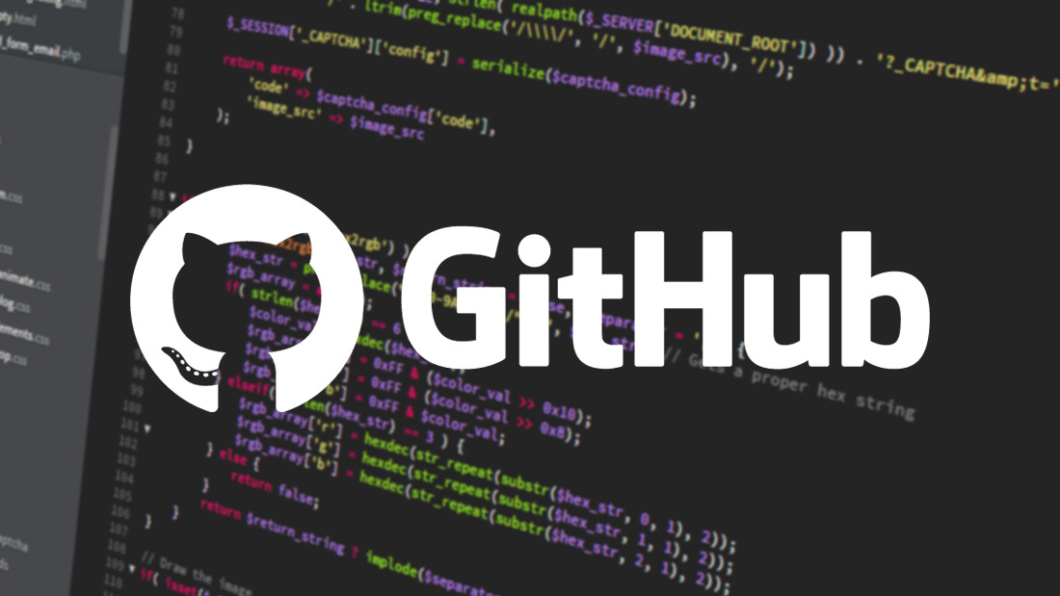
Notes:
30 sec

Slide 4
Mentioning alternatives , account creation and git real-quick + disclaimer
Notes:
30 sec

Slide 5
Disclaimer
We aren’t going to be talking about git or the github apps themselves!
Disclaimer that we are talking about uploading a project using the browser
Notes:
Little explanation on git and apps
Git is software for tracking changes in any set of files, usually used for coordinating work among programmers collaboratively developing source code during software development. Its goals include speed, data integrity, and support for distributed, non-linear workflows (thousands of parallel branches running on different systems).

Slide 6
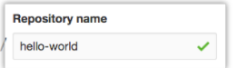
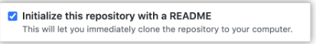
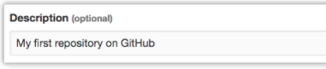
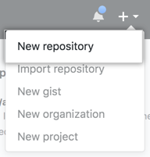

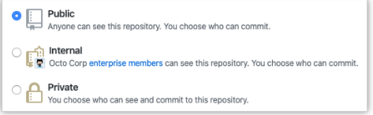
Creating a repository
Notes:
1 min

Slide 7
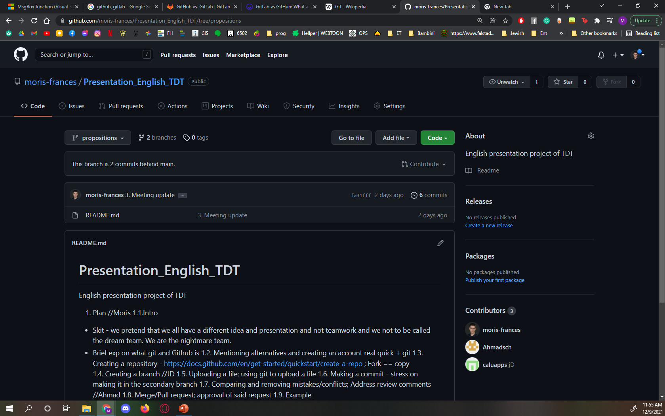
Notes:
15 sec + 10 sec transition to JD

